Slide 1
ELEC5620M Embedded Microprocessor System Design
Unit 1.1 Introduction to Arm Development Studio
Dr David Cowell Module Leader d.m.j.cowell@leeds.ac.uk
Prof Steven Freear

Slide 2

ELEC5620M Module Format
Joint Embedded Systems Introduction Lecture
3 technical units – 2 weeks each
Weekly live unit lectures – now();
Written Notes - Minerva > ELEC5620M > Unit 1 etc
Read notes BEFORE the attempting practical work. You do not need to be at a computer to read these.
Technical Tasks highlighted in the notes.
Starter code downloaded from GitHub Classrooms.
Github Classrooms submission of code for Tasks including incremental changes – Industry Standard
Lab surgery – Fridays 9-11am – Lab 160 Elec. Eng.
Not a teaching session – Work outside class – come with problems.

Slide 3


Reference Textbooks - C
Practical C Programming
The C Programming Language
Minerva > ELEC5620M > Module Information > Module Reading List

Slide 4
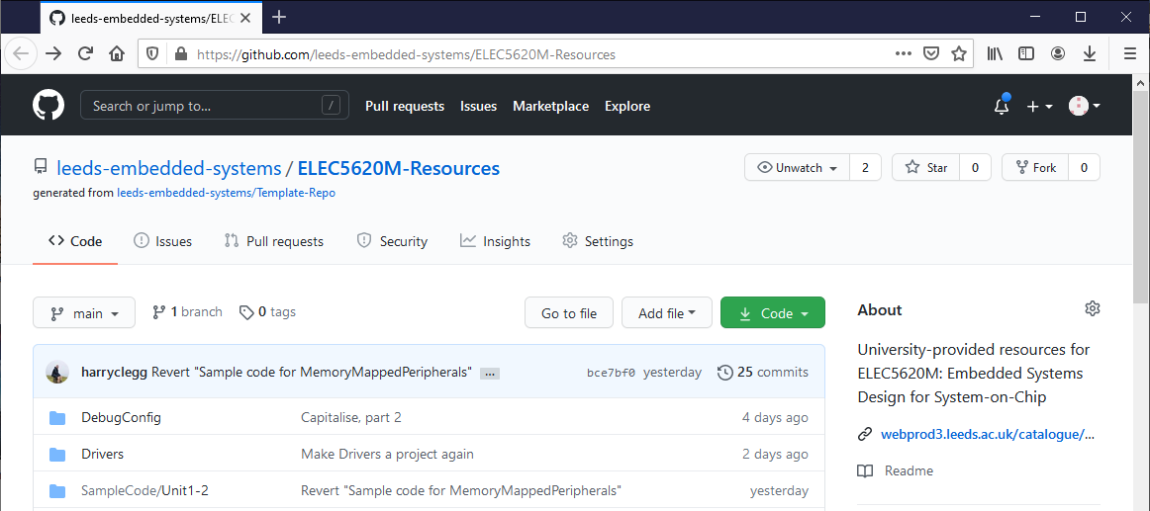
GitHub ELEC5620M-Resources
Minerva > ELEC5620M > General Resources > Lab Resources on GitHub

Slide 5
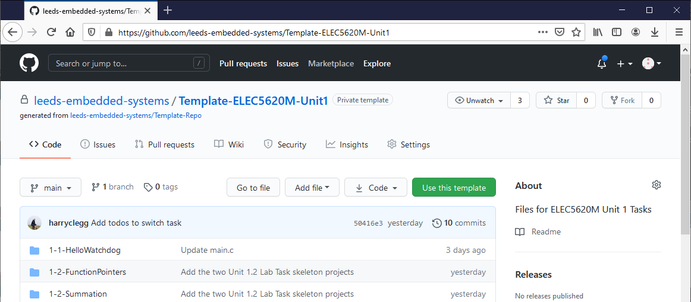
GitHub ELEC5620M-Unit1
Minerva > ELEC5620M > Unit 1 > Unit 1 GitHub Classrooms Resources

Slide 6
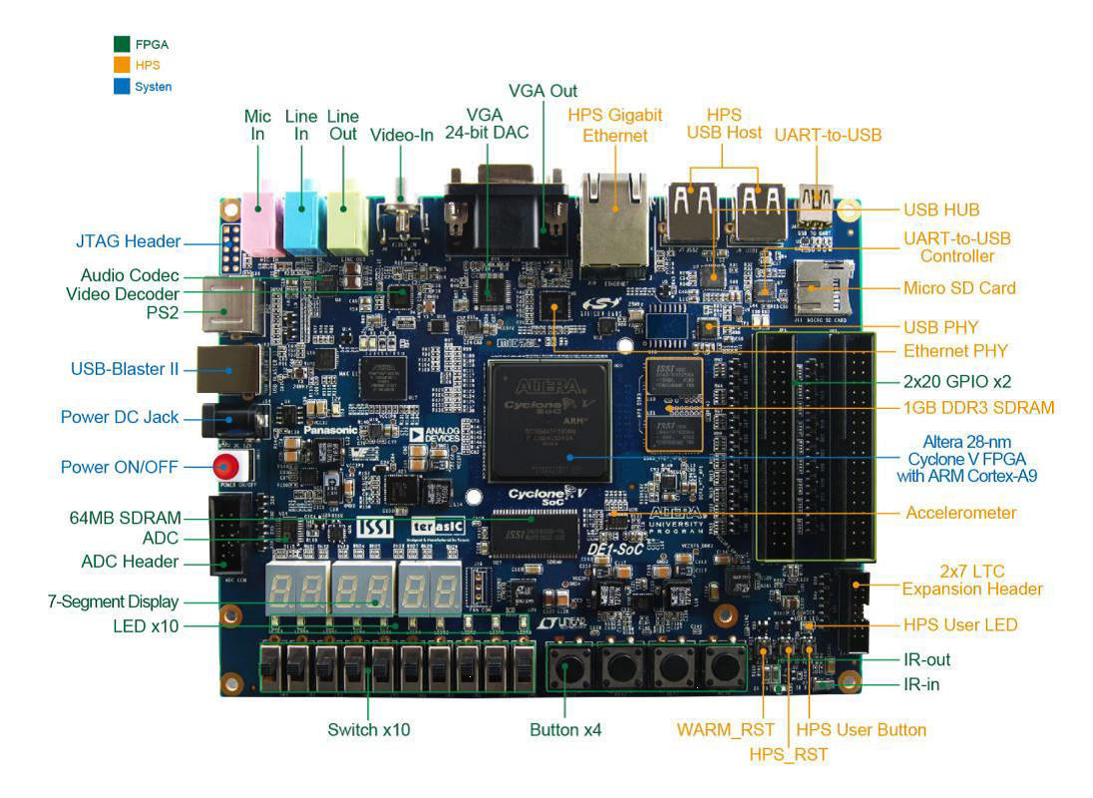

Slide 7
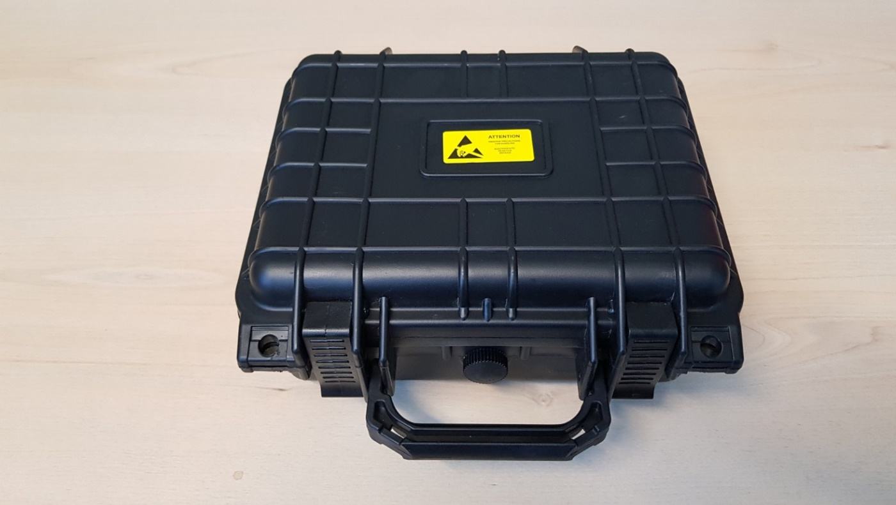
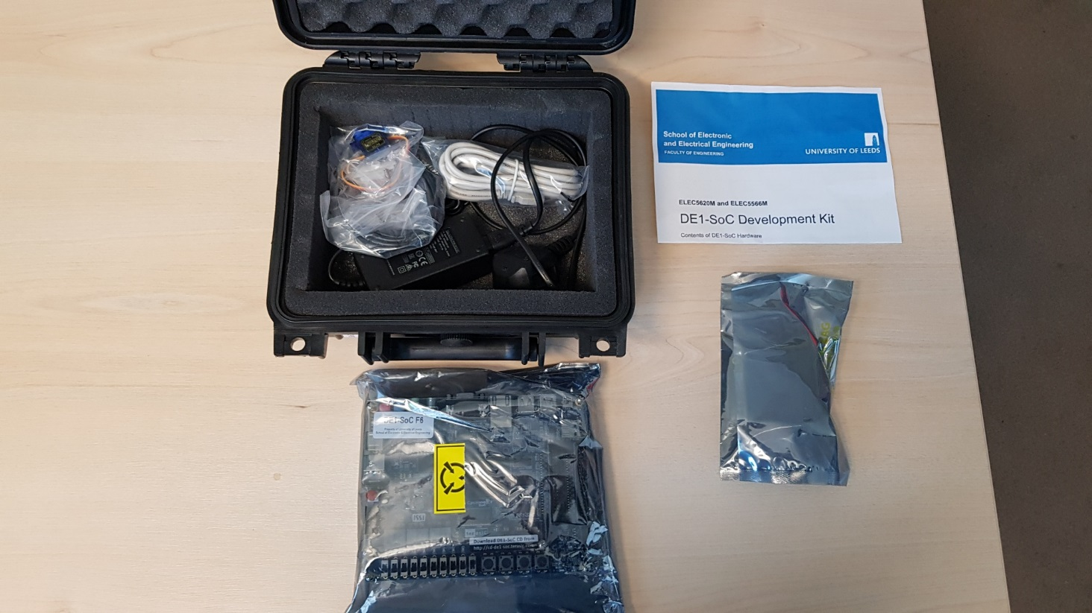
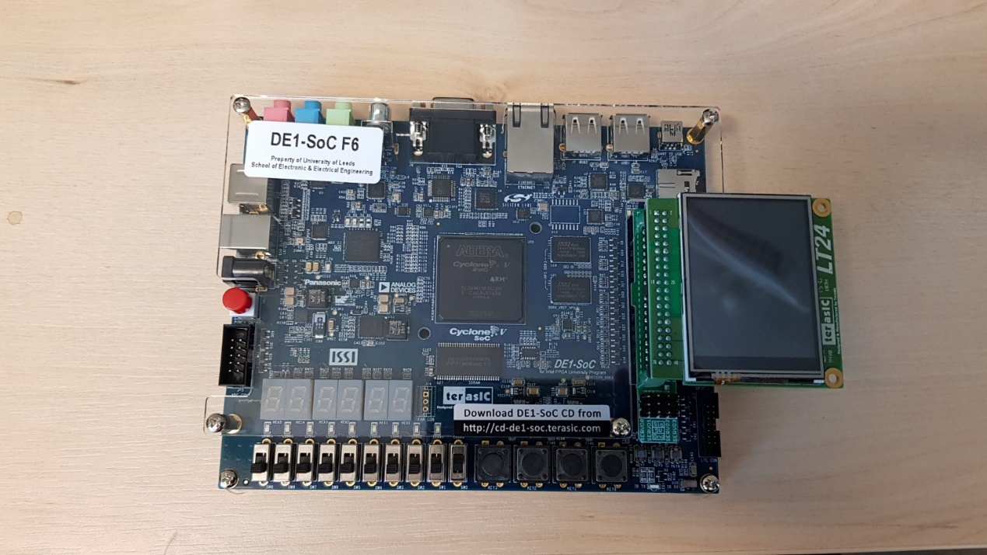
DE1-SoC Hardware
Each student is loaned a DE1-SoC Kit
Expensive system ~£250 (2024: £315 + £54 + £10 + £3 +£2 = £384)
You cannot graduate until your DE1-SoC and accessories are returned!
Can be used for projects after the module with prior agreement.
Do not dispose of the packaging material. Use it when returning kit.
Take ESD precautions. Do NOT touch exposed connections.
Take care plugging in LCD. Check alignment.
Notes:
ELEC5566M Lab 4

Slide 8
DE1-SoC Hardware Health and Safety Rules!
DO NOT leave DE1-SoC hardware unattended if plugged in to AC power supply.
Always use the supplied power supply lead (C8).
Always check the power cable for damage before use.
Always operate hardware on a non-flammable work surface.
Do NOT use the metallic ESD bags as a work surface – they are electrically conductive.
DO NOT cover hardware – no paper, clothes etc.
DO NOT have liquids or food near hardware.
If ANY problem, unplug from AC power supply and computer, then report to module leader.

Slide 9
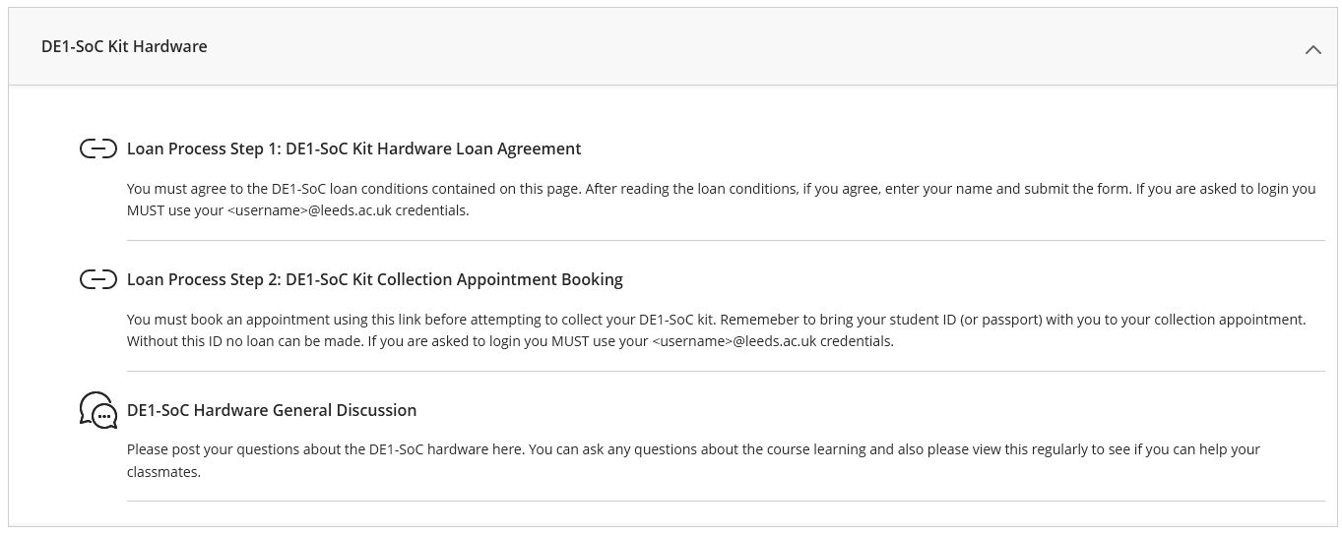
Hardware Loan

Slide 10
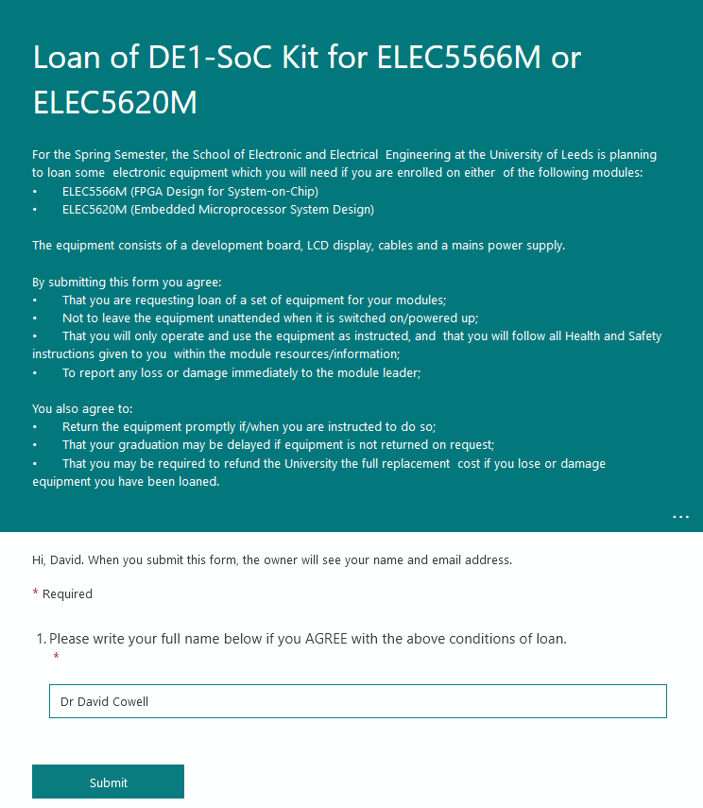
Hardware Loan

Slide 11
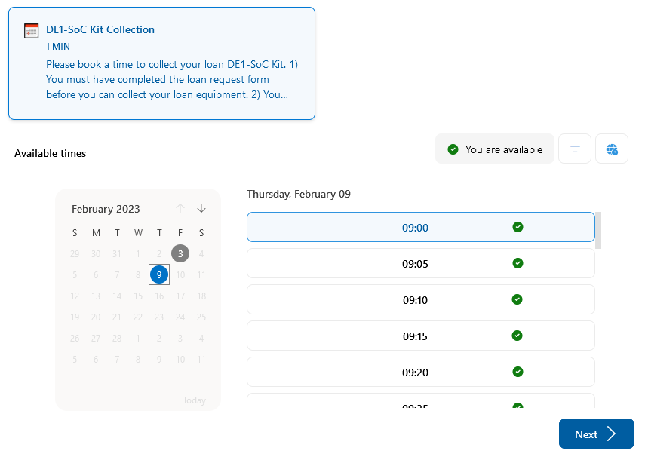
Hardware Loan

Slide 12
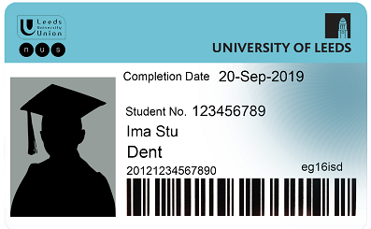
Hardware Loan

Slide 13

Hardware Loan

Slide 14

Hardware Loan

Slide 15
Unit 1.1 Introduction to Arm Development Studio
Introduction to Arm Development Studio
ELEC5620M-Resources
Import project: DebugConfig
ELEC5620M-Unit1
Import 1-1-HelloWatchdog
Configuration
Compilation
Upload configured project to GitHub
Task 1: 1-1-HelloWatchdog
Debug Configuration
Hardware Debug
Tasks 2/3: 1-1-HelloWatchdog

Slide 16
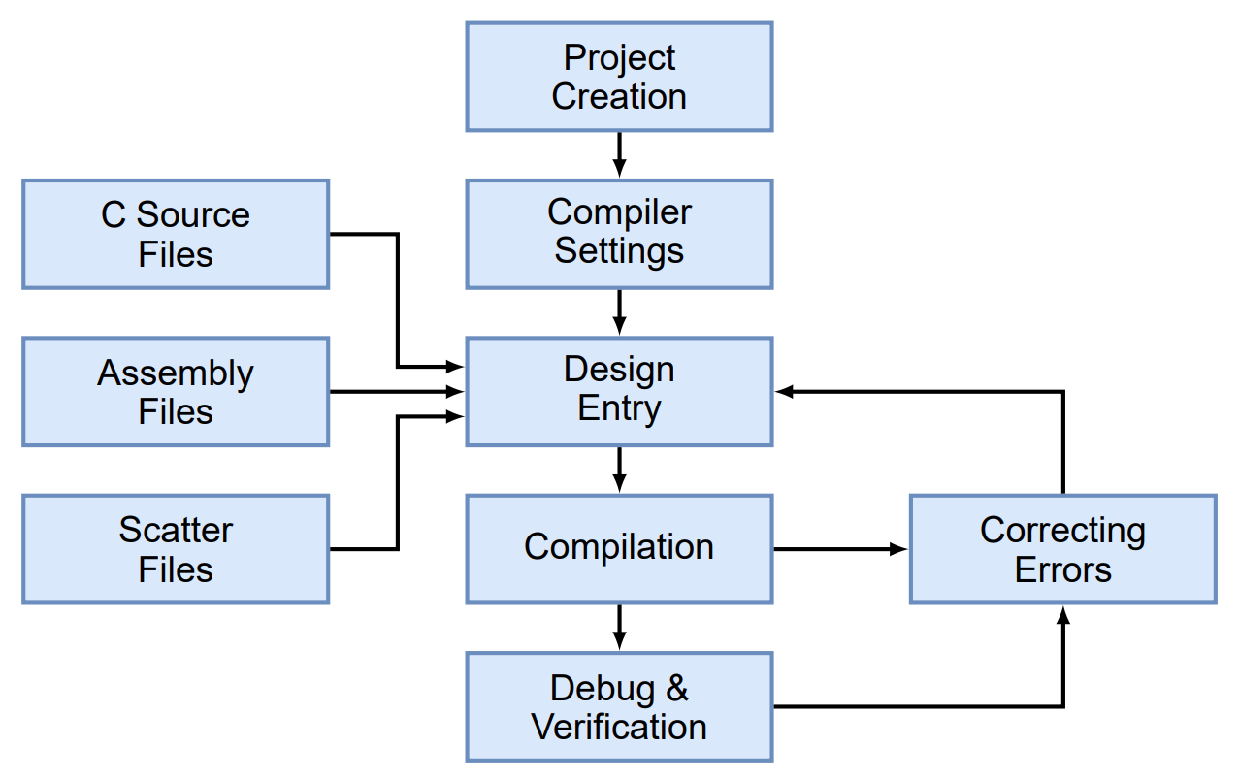
Arm Development Studio Generalised Workflow

Slide 17
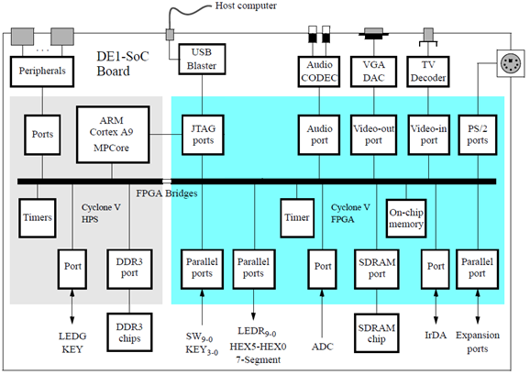

Slide 18
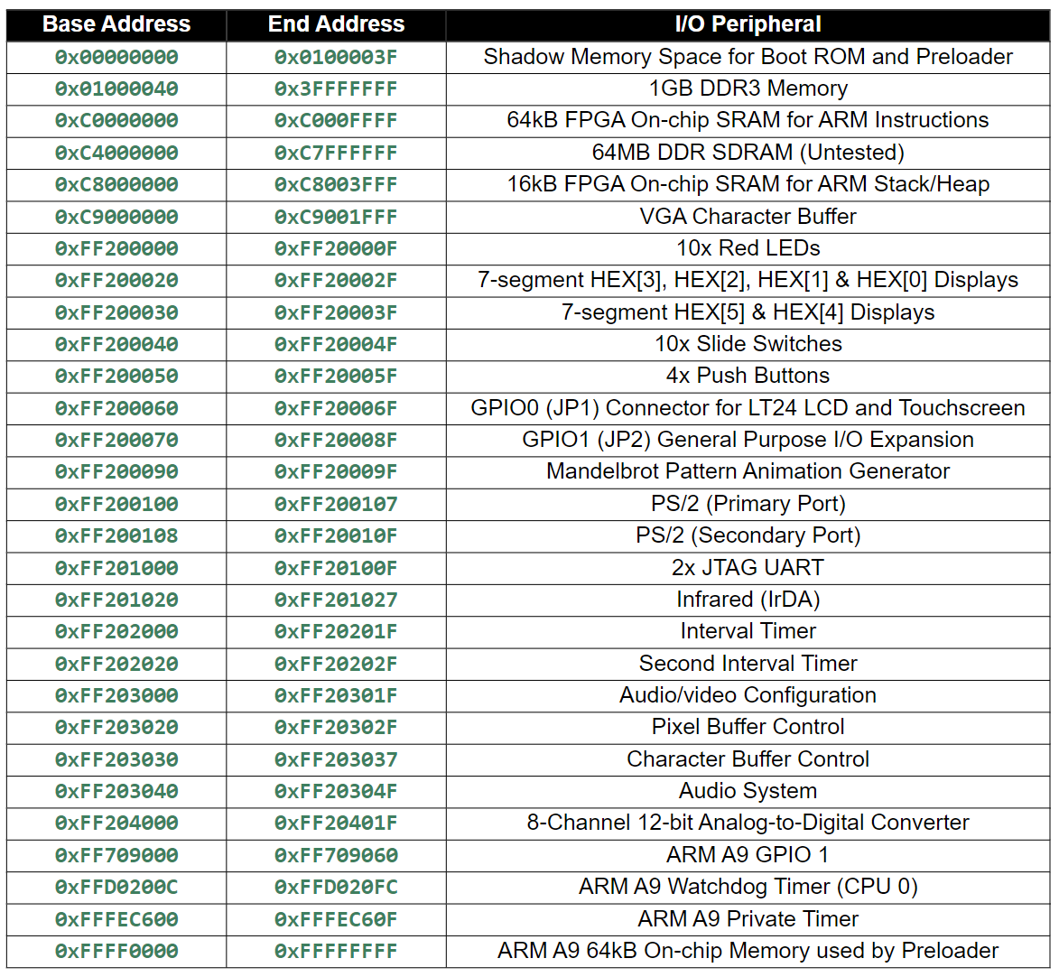

Slide 19
DS-5 Demo

Slide 20
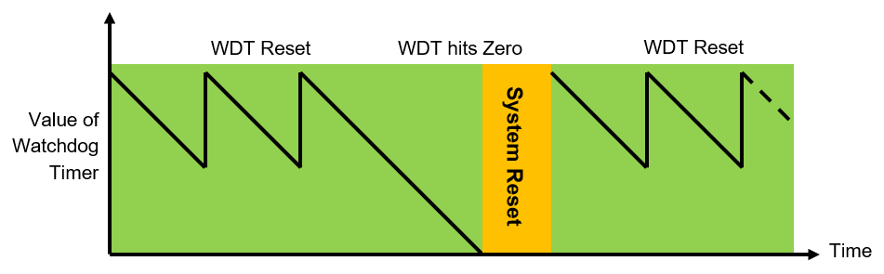
Watchdog Timer

Slide 21
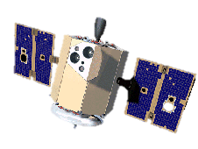
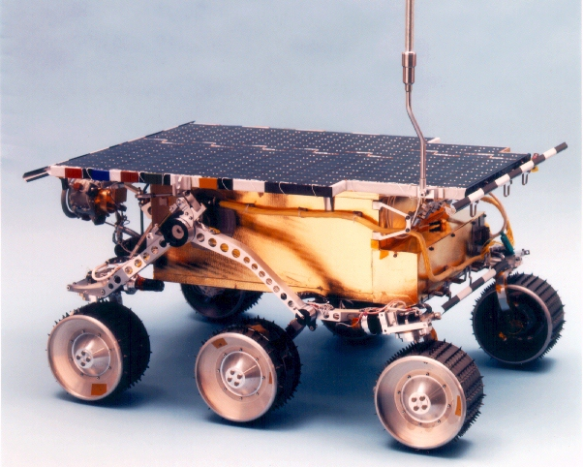

Watchdogs in Space!
NASA Clementine
NASA Pathfinder
NASA Spirit
https://www.nasa.gov/mission_pages/LCROSS/searchforwater/clementine.html
https://mars.nasa.gov/MPF/roverpwr/power.html
https://www.nasa.gov/vision/universe/solarsystem/30dec_gusevcrater.html

Slide 22
Watchdogs in Space!
NASA Clementine
NASA Pathfinder
NASA Spirit
https://www.nasa.gov/mission_pages/LCROSS/searchforwater/clementine.html
https://mars.nasa.gov/MPF/roverpwr/power.html
https://www.nasa.gov/vision/universe/solarsystem/30dec_gusevcrater.html

Slide 23
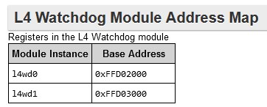
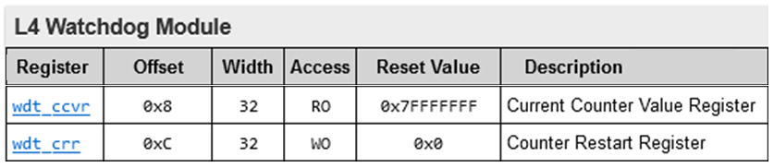
Watchdog Timer Reset
See Minerva > ELEC5620M > General Resources > Cyclone V HPS Register Address Map and Definitions
Challenge: Use debugger and check the wdt_torr register to determine wdt_ccvr reset value.

Slide 24
1-1-HelloWatchdog main.c
int main(void) {
// Declare pointers to I/O registers (volatile keyword means memory not cached)
volatile unsigned int *wdt_ccvr = (unsigned int *)0xFFD02008; // WDT Current Value Register (l4wd0: wdt_ccvr)
volatile unsigned int *wdt_crr = (unsigned int *)0xFFD0200C; // WDT Counter Reload Register (l4wd0: wdt_crr)
volatile unsigned int *LEDR_ptr = (unsigned int *)0xFF200000; // Red LEDs base address
volatile unsigned int *KEY_ptr = (unsigned int *)0xFF200050; // KEY buttons base address
// Primary Run Loop - Bare-Metal Applications use an infinite loop to keep executing (no OS).
while (1) {
// Read WDT counter value and display it on the red LEDs (scaled to fit).
*LEDR_ptr = *wdt_ccvr >> 16;
//Check if any of the buttons have been pressed.
//Each of the lower 4 bits represents one of the keys. A key is pressed if the corresponding bit is 1.
if (*KEY_ptr & 0xF) {
// If any key pressed
*wdt_crr = 0x76; // Reset the Watchdog Timer
}
}
}

Slide 25

Watchdog Timer Reset
// WDT Counter Reload Register (l4wd0: wdt_crr)
volatile unsigned int *wdt_crr = (unsigned int *)0xFFD0200C;
*wdt_crr = 0x76; // Reset the Watchdog Timer – Pat the dog!

Slide 26

Watchdog Timer Reset
// WDT Counter Reload Register (l4wd0: wdt_crr)
volatile unsigned int *wdt_crr = (unsigned int *)0xFFD0200C;
*wdt_crr = 0x76; // Reset the Watchdog Timer – Pat the dog!

Slide 27
Questions

Slide 28
Additional Slides
Memory Mapping and Bit Manipulation

Slide 29
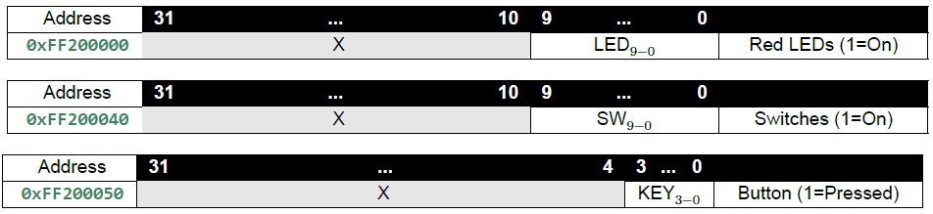
Bit shifting 1-1-HelloWatchdog - main.c
/**
* Primary Run Loop.
* Bare-Metal Applications use an infinite loop to keep executing (no OS).
*/
while (1) {
// Read WDT counter value, and display it on the red LEDs (scaled to fit).
*LEDR_ptr = *wdt_ccvr >> 16;
/**
* Check if any of the buttons have been pressed. Each of the lower 4
* bits represents one of the keys. A key is pressed if the
* corresponding bit is 1.
*/
if (*KEY_ptr & 0xF) {
// If any key pressed
*wdt_crr = 0x76; // Reset the Watchdog Timer
}
}
}
bit 31 30 29 28 27 26 25 24 23 22 21 20 19 18 17 16 15 14 13 12 11 10 9 8 7 6 5 4 3 2 1 0
*wdt_ccvr 0 0 0 0 0 0 1 1 1 1 1 1 1 1 1 1 1 1 1 1 1 1 1 1 1 1 1 1 1 1 1 1
16 lost bits
16 Zero Padding Bits
*wdt_ccvr>>16 0 0 0 0 0 0 0 0 0 0 0 0 0 0 0 0 0 0 0 0 0 0 1 1 1 1 1 1 1 1 1 1
Example of bit shifting – Lookup >> and << in reference texts.

Slide 30
Bit masking 1-1-HelloWatchdog - main.c
/**
* Primary Run Loop.
* Bare-Metal Applications use an infinite loop to keep executing (no OS).
*/
while (1) {
// Read WDT counter value, and display it on the red LEDs (scaled to fit).
*LEDR_ptr = *wdt_ccvr >> 16;
/**
* Check if any of the buttons have been pressed. Each of the lower 4
* bits represents one of the keys. A key is pressed if the
* corresponding bit is 1.
*/
if (*KEY_ptr & 0xF) {
// If any key pressed
*wdt_crr = 0x76; // Reset the Watchdog Timer
}
}
}
bit 31 30 29 28 27 26 25 24 23 22 21 20 19 18 17 16 15 14 15 13 12 11 10 09 08 07 06 05 04 03 02 01 00
*KEY_ptr X X X X X X X X X X X X X X X X X X X X X X X X X X X X X 0 0 0 1
0xF (0x000F) 0 0 0 0 0 0 0 0 0 0 0 0 0 0 0 0 0 0 0 0 0 0 0 0 0 0 0 0 0 1 1 1 1
(*KEY_ptr & 0xF) 0 0 0 0 0 0 0 0 0 0 0 0 0 0 0 0 0 0 0 0 0 0 0 0 0 0 0 0 0 0 0 0 1

Slide 31
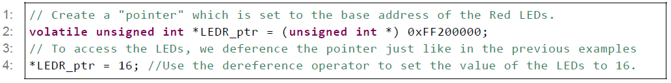
C Pointers Memory Mapped Peripherals

Slide 32
1-1-HelloWatchdog main.c
int main(void) {
// Declare pointers to I/O registers
// (volatile keyword means memory not cached)
// WDT Current Value Register (l4wd0: wdt_ccvr)
volatile unsigned int *wdt_ccvr = (unsigned int *)0xFFD02008;
// WDT Counter Reload Register (l4wd0: wdt_crr)
volatile unsigned int *wdt_crr = (unsigned int *)0xFFD0200C;
// Red LEDs base address
volatile int *LEDR_ptr = (int *)0xFF200000;
// KEY buttons base address
volatile int *KEY_ptr = (int *)0xFF200050;
...

Slide 33
1-1-HelloWatchdog - main.c
/**
* Primary Run Loop.
* Bare-Metal Applications use an infinite loop to keep executing (no OS).
*/
while (1) {
// Read WDT counter value, and display it on the red LEDs (scaled to fit).
*LEDR_ptr = *wdt_ccvr >> 16;
/**
* Check if any of the buttons have been pressed. Each of the lower 4
* bits represents one of the keys. A key is pressed if the
* corresponding bit is 1.
*/
if (*KEY_ptr & 0xF) {
// If any key pressed
*wdt_crr = 0x76; // Reset the Watchdog Timer
}
}
}

